Slide 1
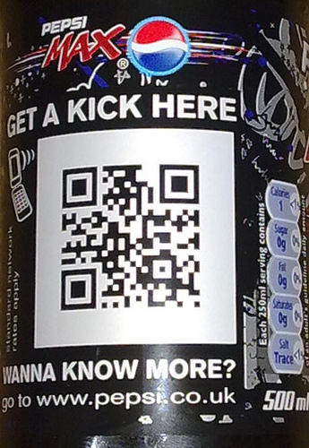
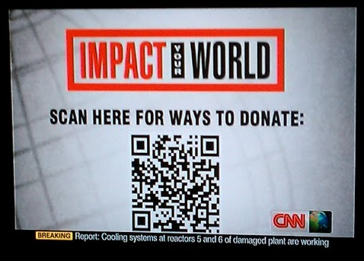
QR Codes
Kara Damm
Technology Integration Specialist
SW/WC Service Cooperative

Slide 2
What is a QR Code
Abbreviated Quick Response Code
Can be used in education
On the iPad, please click on the app called “Qrafter”
Click SCAN WITH CAMERA (click the camera icon)
Point the camera at the QR Code on the following screens

Slide 3
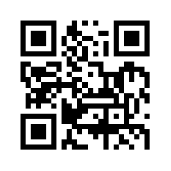
Math Bytes as you enter the room
On your iPad, click on Open URL in Safari

Slide 4
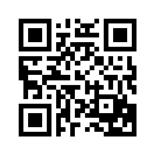
Send someone to your social media page

Slide 5
W o r k s h e e t s

Slide 6
W o r k s h e e t s

Slide 7
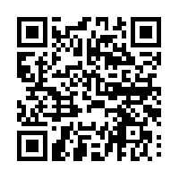
Video for class

Slide 8
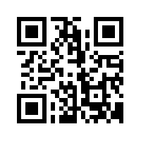
How do you make this?

Slide 9
examples
Put some QR codes around the school.
One in the entrance - linking to a text of the school mission statement or URL of school website.
One in the corridor - linking to school vision.
One (or more) outside every classroom with planning of work being completed within, audio of music compositions or poetry recitals, slideshows of artwork etc.
One in the library with associated audio clips of pupil book reviews.
...others that you will inevitably think of.
Give visitors/inspectors a device when they arrive
Dughall McCormick @dughall

Slide 10
examples
A link to the teacher dropbox
In an elementary classroom, use the QR Code on objects to teach what they are (using a sound clip) http://qrvoice.net/

